Slide 1




CYBER SECURITY
Security information & event management:
siem
SPLUNK ON KALI LINUX:
A POWERFUL SECURITY TOOl

Slide 2
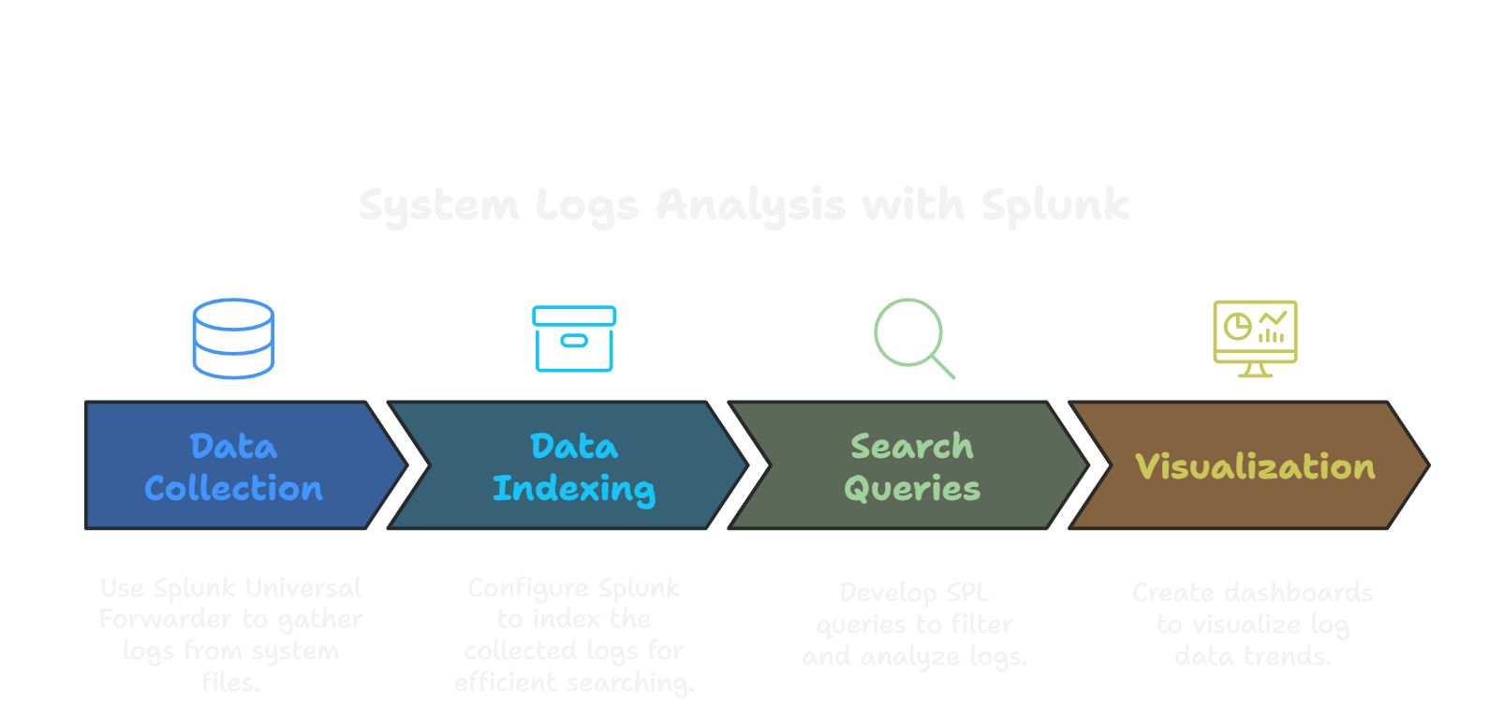
TESTING SYSTEM LOGS
Splunk helps identify unusual patterns in system logs, indicating potential security incidents.
Identify anamolies
Analysing root cause
To collect, analyze, and visualize system logs from various sources.
To identify patterns, anomalies, and potential security incidents. This includes failed login attempts, unusual file accesses, and unexpected software behavior.

Slide 3
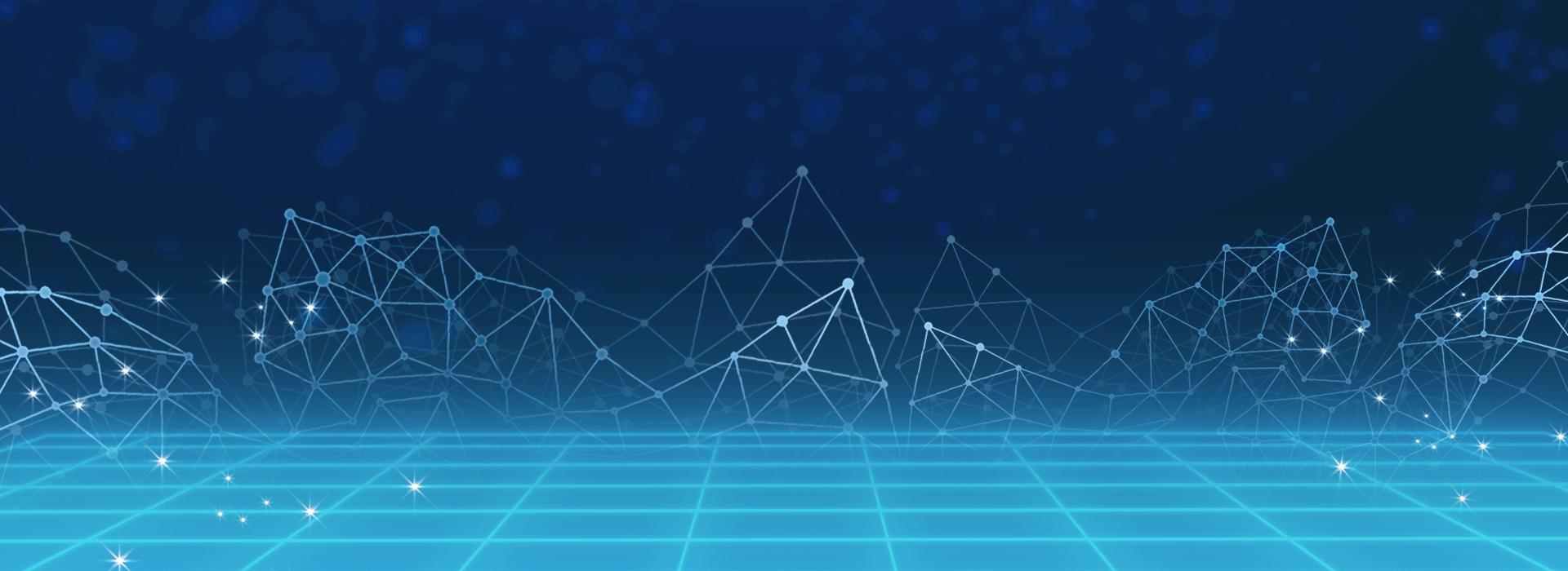
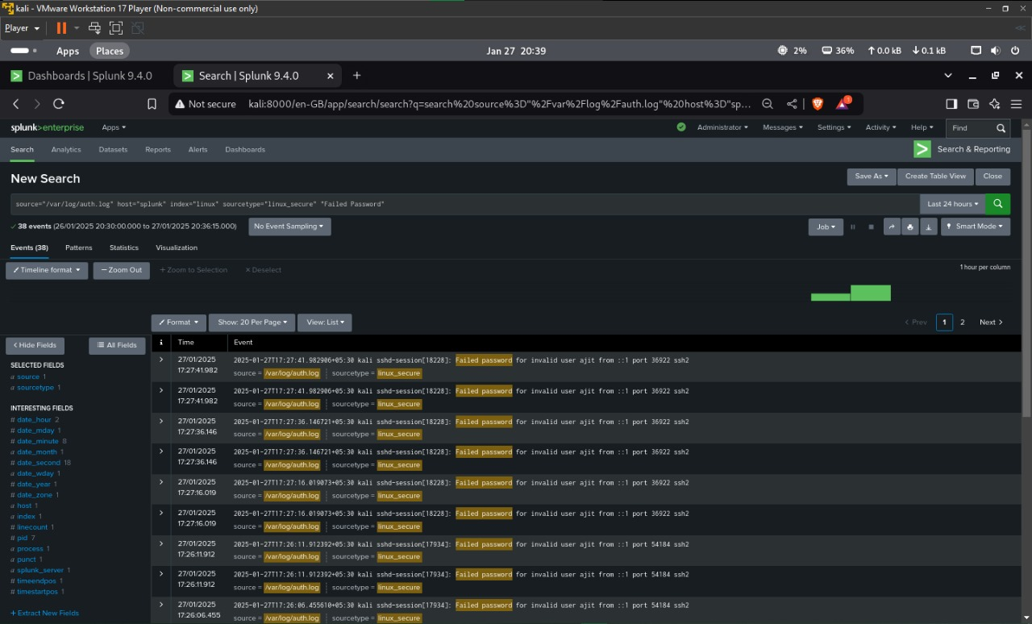
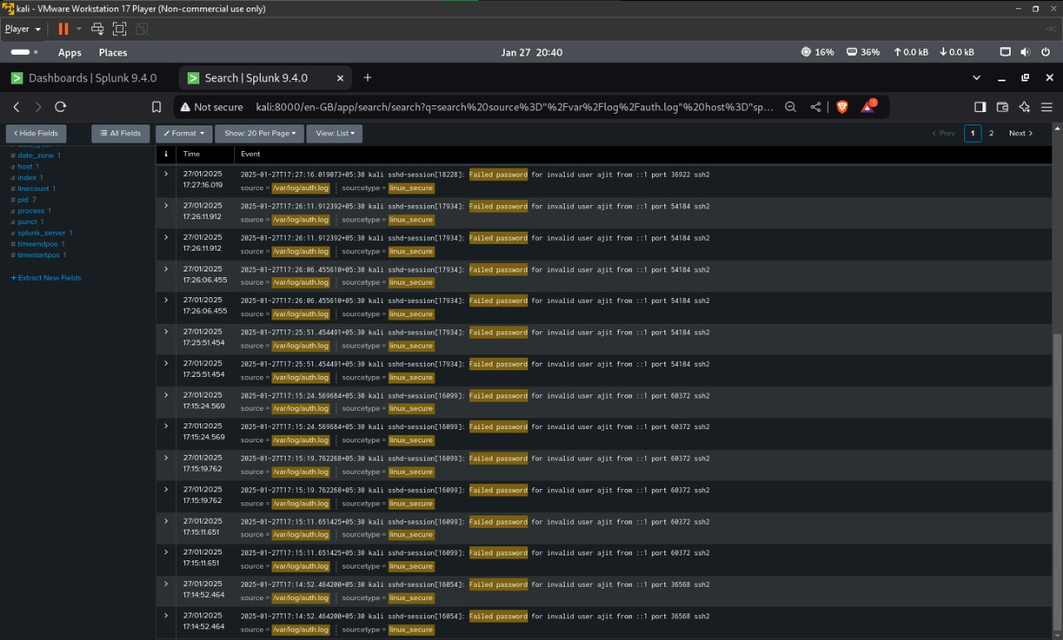

Slide 4


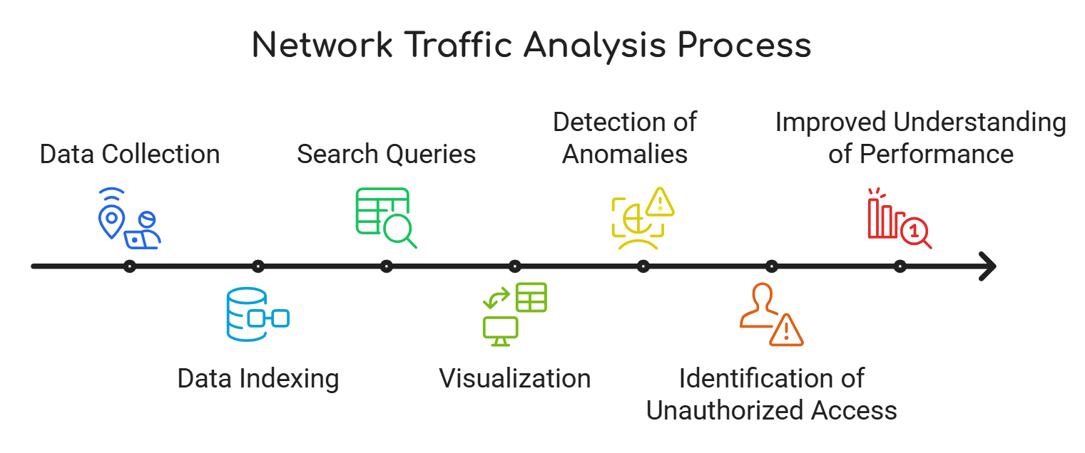

NETWORK TRAFFIC ANALYSIS
Traffic patterns
Splunk monitors network traffic to identify unusual patterns
Excessive bandwidth consumption
Suspicious connections
Known malicious activity.
Threat detection
Splunk analyzes network traffic to detect and identify known and emerging threats
Includes malware, phishing attempts, and botnets.
Detection of DDoS attacks, port scans, and unusual traffic patterns.

Slide 5
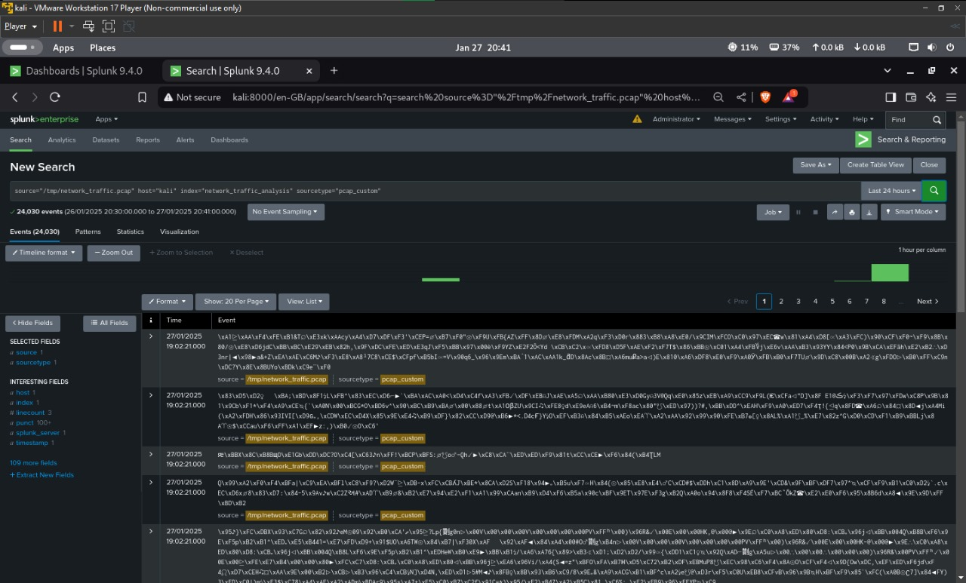

Slide 6
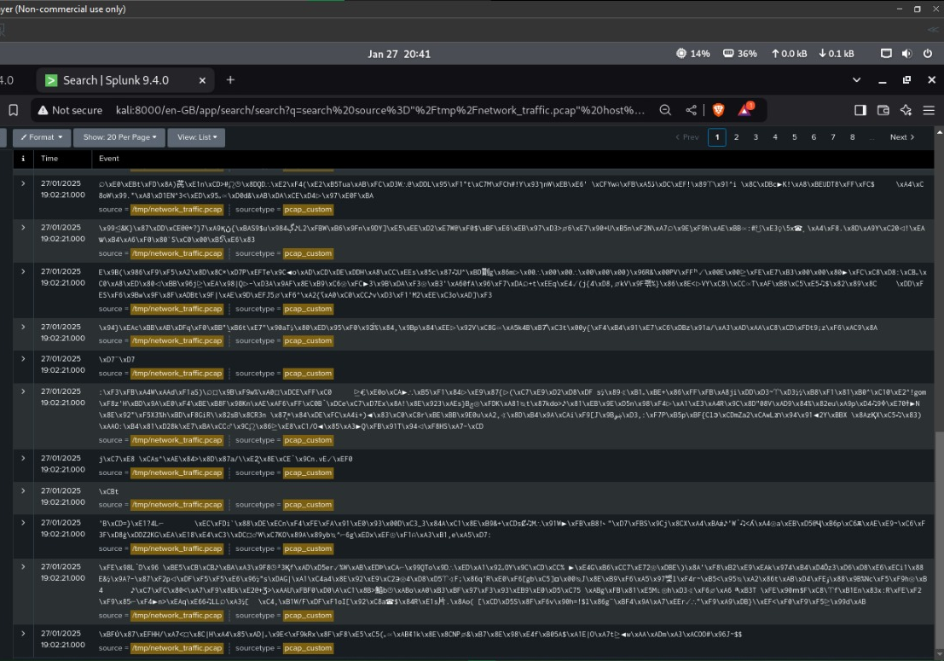

Slide 7
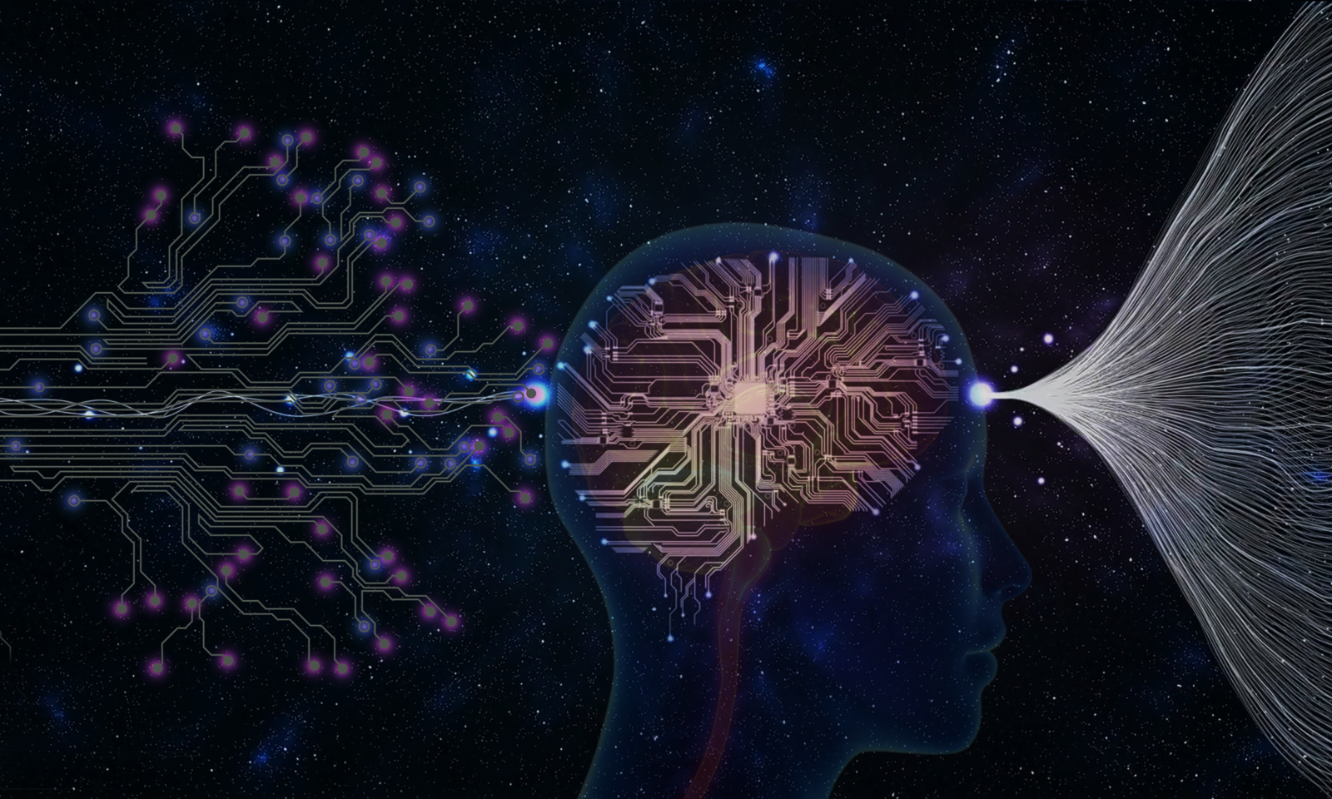
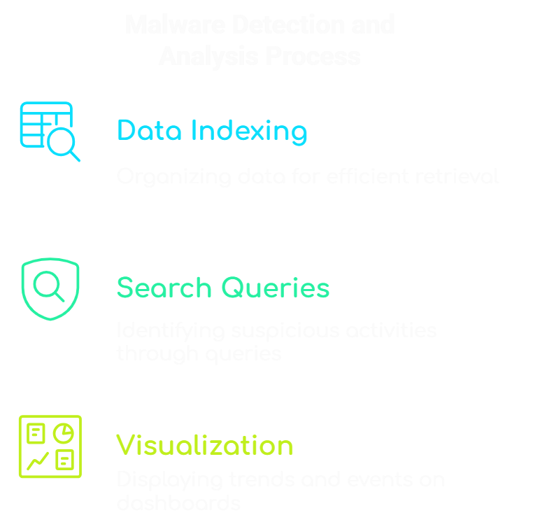
Malware detection
Autonomous vehicles, or self-driving cars, are set to transform the transportation industry. By leveraging advanced sensors, AI, and real-time data, these vehicles can navigate roads with minimal human intervention. The adoption of autonomous vehicles promises to enhance road safety, reduce traffic congestion, and provide greater mobility options, particularly for those who are unable to drive.

Slide 8
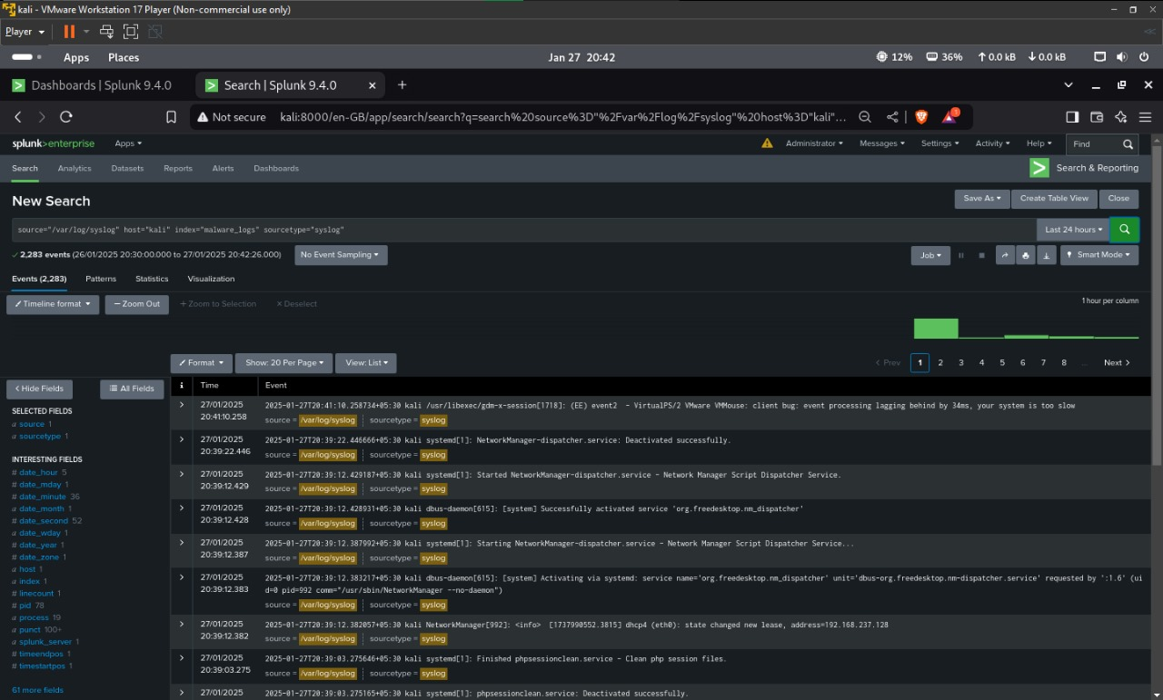

Slide 9
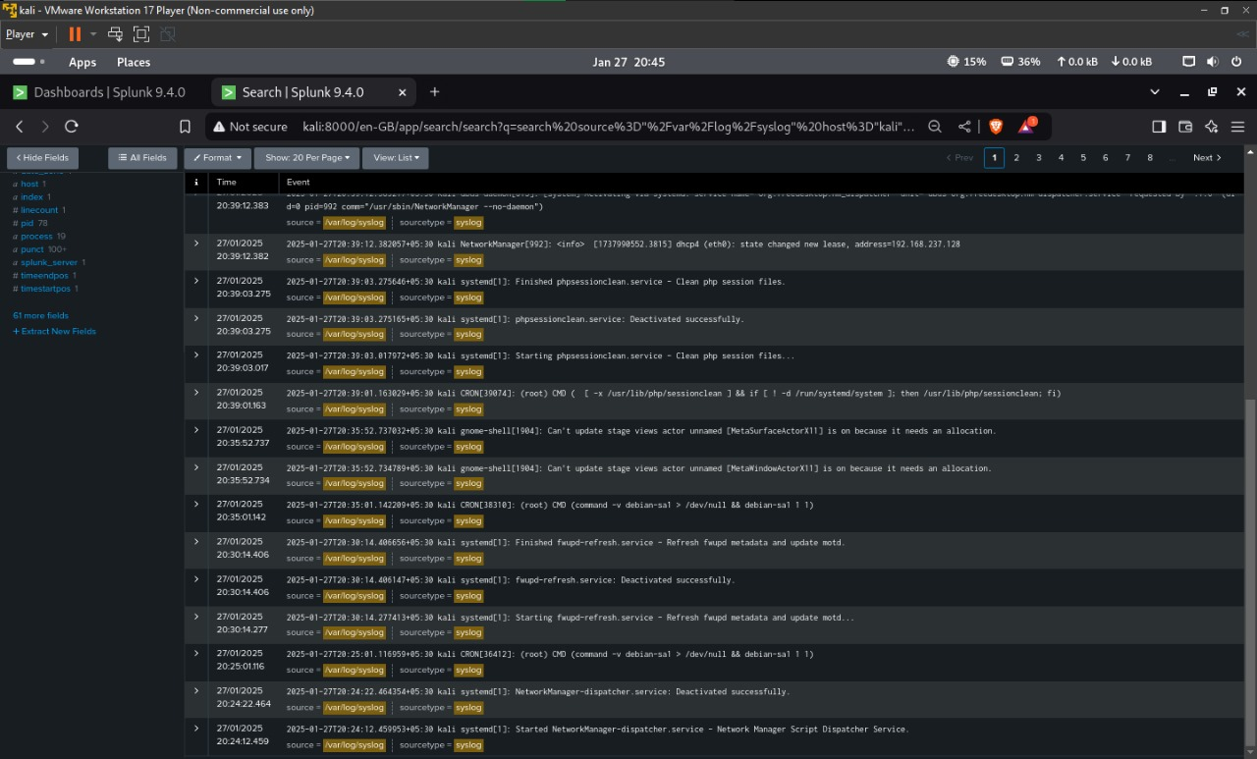

Slide 10


Real-Time Threat Monitoring
1.
2.
3.
System Logs
Failed Passwords
Firewall Logs
Sends an alert to the mail id if there is any change in system logs or if someone uses bash, ssh, or sudo commands very often.
Sends an alert to the mail id if there is any unauthorized logins to the system, detecting any slightest change of users in the system.
These logs give an alert to the mail id if someone tries to maliciously access the system or induces a malware into it.

Slide 11
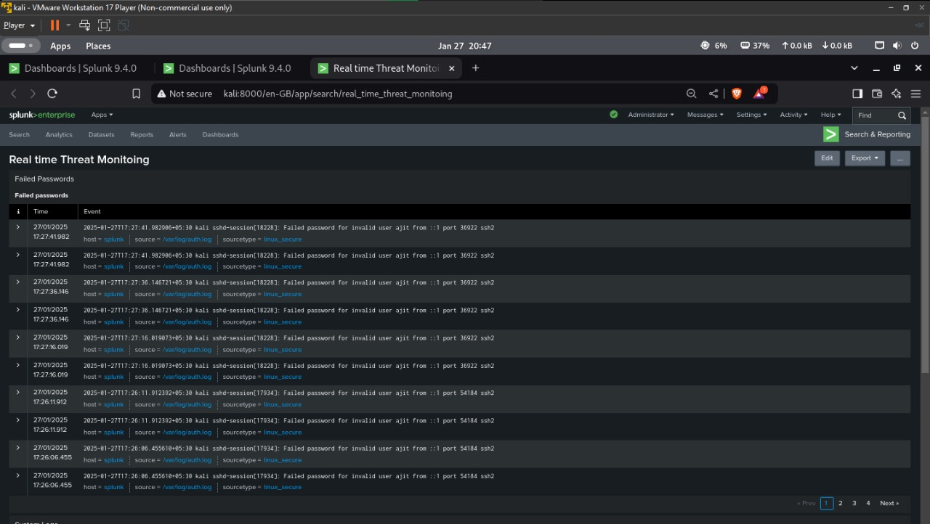
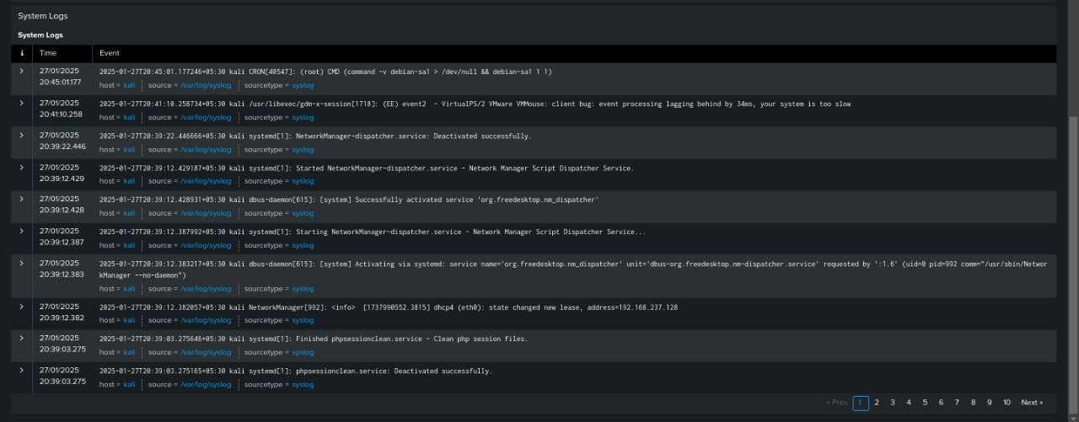

Slide 12
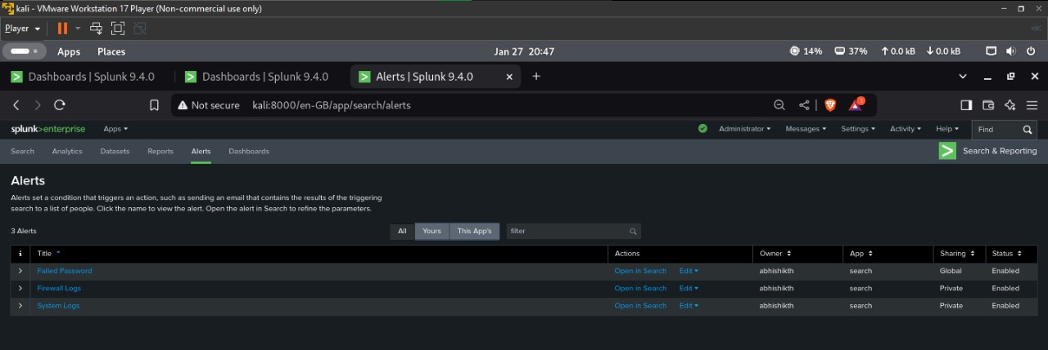
Establishing alerts
Establishing alerts to detect and deploy an alert to given methods about the changes in the system, monitoring Real – Time threats to the system.

Slide 13
THANK YOU!
Together, let’s build a safer and more secure digital world.

